Slide 1
POLE PLACEMENT TECHNIQUE

Slide 2

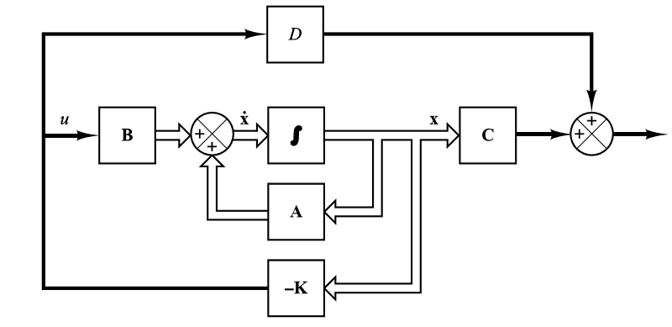
Pole placement technique
The objective is to maintain zero output
This is called as regulator system

Slide 3


Substituting u = - Kx in the system state equation
The solution of this equation is given by
x(0) is the initial state caused by external disturbance
The stability and transient response characteristics are determined by eigen values of the matrix A- BK

Slide 4
If the matrix K is chosen properly, A-BK can be made asymptotically stable matrix
The Eigen values of A-BK is called as regulator poles
This problem of placing the regulator poles are desired location is called as pole placement technique
The arbitrary pole placement is possible only if the system is completely state controllable

Slide 5
Determination of matrix K
Using transformation matrix T
We have to find the value of K such that the eigen values of A-BK to be μ₁, μ₂, μ₃, ,……. μ_{n} (desired values)
Step 1:
Check the controllability condition for the system

Slide 6


Using direct substitution method
If the order of the system is less than or equal to 3, direct substitution of matrix K into the desired characteristics polynomial may be simpler.
Say if the order is 3 then the state feedback gain matrix K can be written as
Since both sides of this equations are polynomials in s, the coefficient of like powers can be equated to get the K values.
For higher order this approach is tedious.

Slide 7
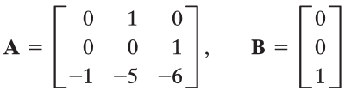

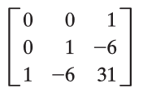
Problem:
For the state space model given by the equation
that uses the state feedback control u = - Kx. Design a state feedback gain matrix K such that the desired poles locations are
Solution:
Step 1: We have to check the controllability of this system

Slide 8


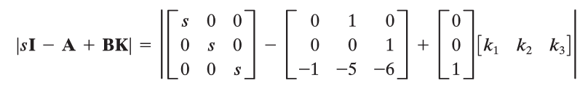
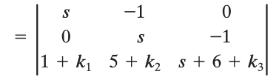
Method I
The characteristic equation using the state feedback gain matrix
is given by

Slide 9


With the desired closed loop poles at
Deriving the desired characteristic equation as
Comparing the coefficients, we get

Slide 10
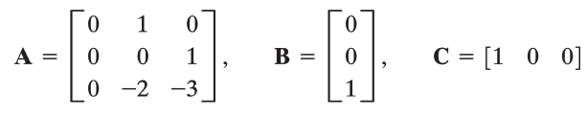
Example 2:
The desired closed loop poles are
Determine the state feedback gain matrix K

Slide 11
The characteristic equation using the state feedback gain matrix is given by

